Slide 1


Slide 2
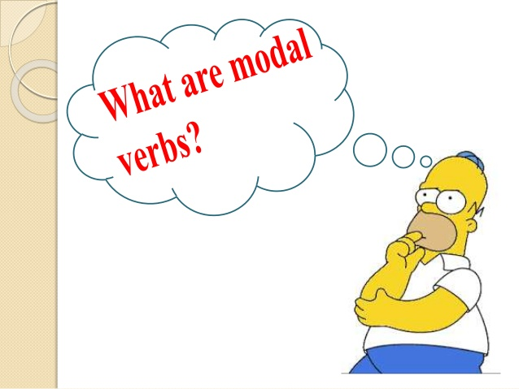
A modal verb is a type of auxiliary (helping) verb and used with other verbs to express: ability, possibility, permission request, capacity, suggestions, order, advice or obligation.

Slide 3
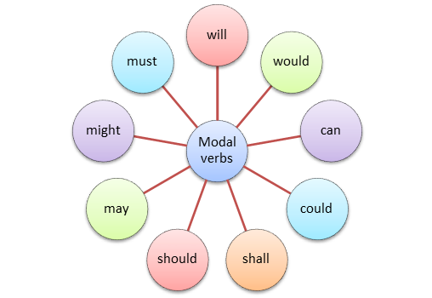
Modal verbs include

Slide 4
Poll Question
Which of the following is not a modal?
will
should
take
could

Slide 5

Answer
OPTION-C

Slide 6
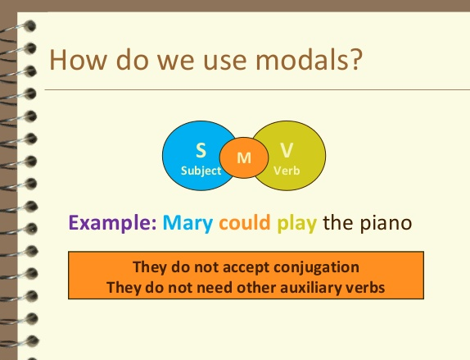

Slide 7


FORM
Modal verbs do not have infinitives or –ing forms.
to can / caning /to must /musting
Modal verbs are followed by an infinitive without to
She must study (strong obligation)
Modal verbs do not have all the tenses.

Slide 8
Poll Question
Which of the following is true about MODALs?
Modals accept conjugation
They need other auxiliary verbs.
Modal verbs do not have infinitives or –ing forms.
Modal verbs have infinitives forms

Slide 9
Answer
OPTION-C

Slide 10


What do they Express…….??????? They can have more than one meaning depending on the situations.

Slide 11
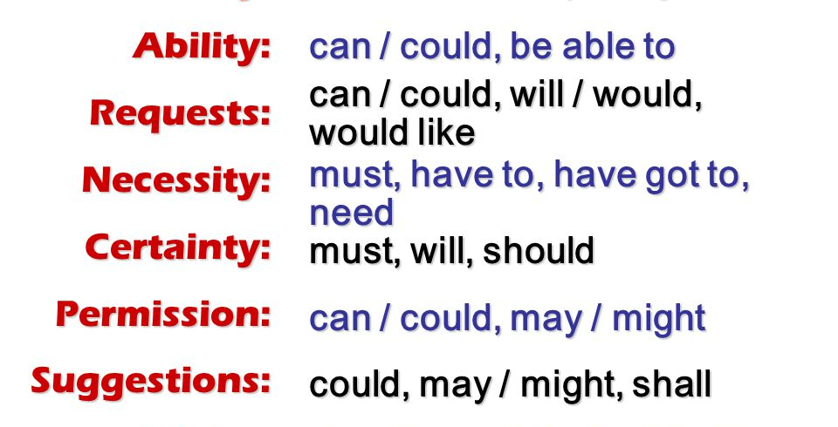

Slide 12

EXPLANATION

Slide 13
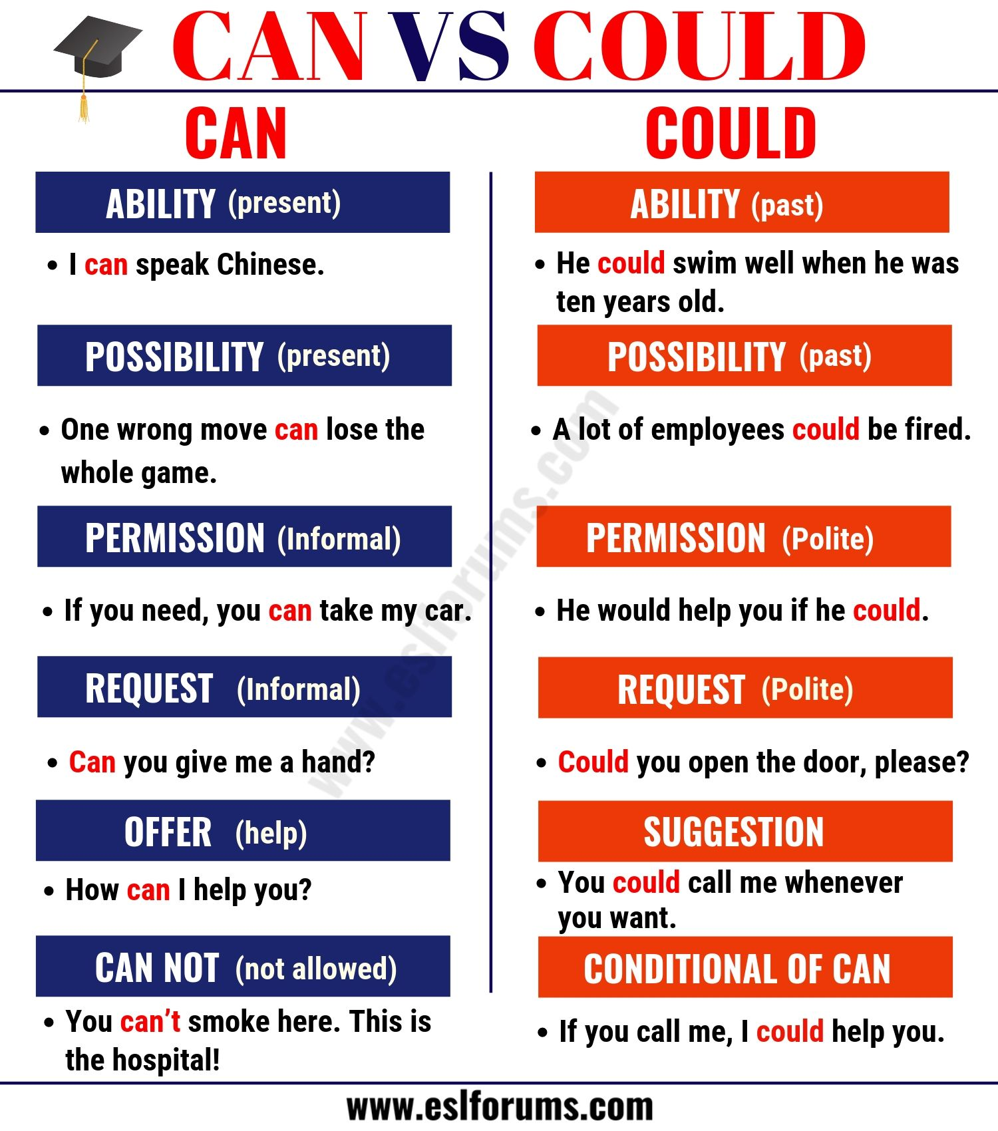

Slide 14
Poll Question
Which of the following is the function of modal can/can't ....?
A. To make a procedure
B. To show ability
C. To congratulate someone
D. To give our opinion

Slide 15
Answer
OPTION-B

Slide 16
MORE EXAMPLES:-
He can play the piano.( Ability)
I can go now that I’ve finished working.(Opportunity)
Can I borrow your book? ( Informal request)
It can be tiring to study and work at the same time. ( Possibility)
Could you phone me when you arrive? (Polite request)
You could have taken a long weekend to visit your family.( Suggestion in past)
Before I hurt my wrist, I could toss pizza dough.( Past of CAN)

Slide 17
Poll Question
When he was young, he ________ swim very well. He won medals and championships!
A) Could
B) Can
C) Had
D) Must

Slide 18
Answer
Option-A

Slide 19


Slide 20
Poll Question
Which of the following is used to express very less possibility?
May
Might

Slide 21
Answer
OPTION- B

Slide 22
MORE EXAMPLES:-
You may submit your paper via email now.
The bakery may be open now.
May I use your phone?
My dog might be the one who made the mess.
You might have called to say you weren’t coming.

Slide 23
Poll Question
The company ________ go bankrupt if they don't find a lot of money quickly!
A) Can
B) Might
C) Had
D) Should

Slide 24
Answer
Option- B

Slide 25
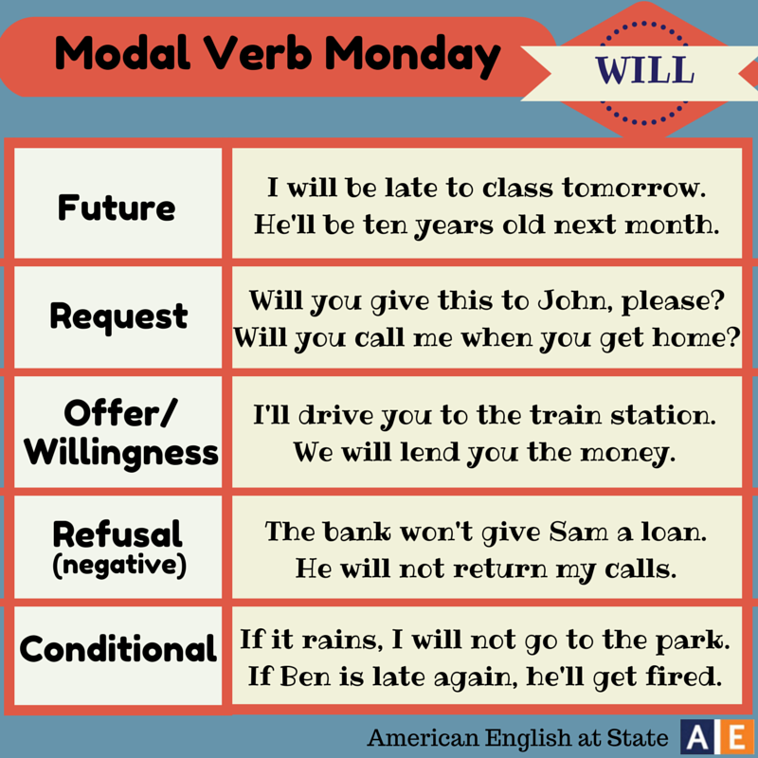
USE OF WILL

Slide 26
MORE EXAMPLES:-
John will be in his office. We'll be late. We will have to take the train.
I'll give you a lift home after the party.
Dan will help you if you ask him.

Slide 27
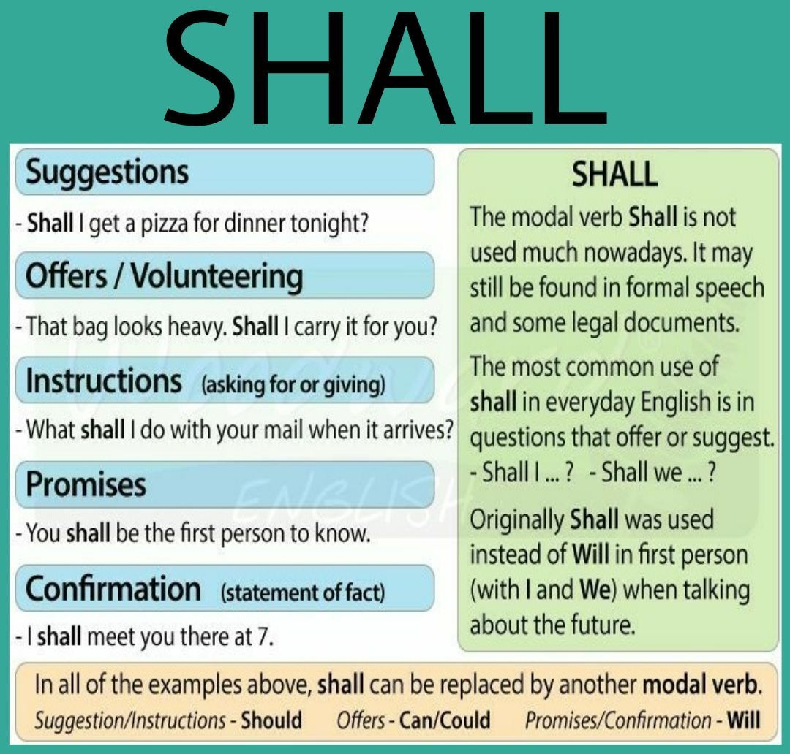

Slide 28
MORE EXAMPLES:-
One day, we shall overcome our dependence on oil.
I shall ensure that everything goes according to plan.
Shall we go now ?
She shall get a saree if she stands first.

Slide 29
Poll Question
______ we order a pizza?
A) Shall
B) May
C) Couldn’t
D) Might

Slide 30
Answer
OPTION- A

Slide 31
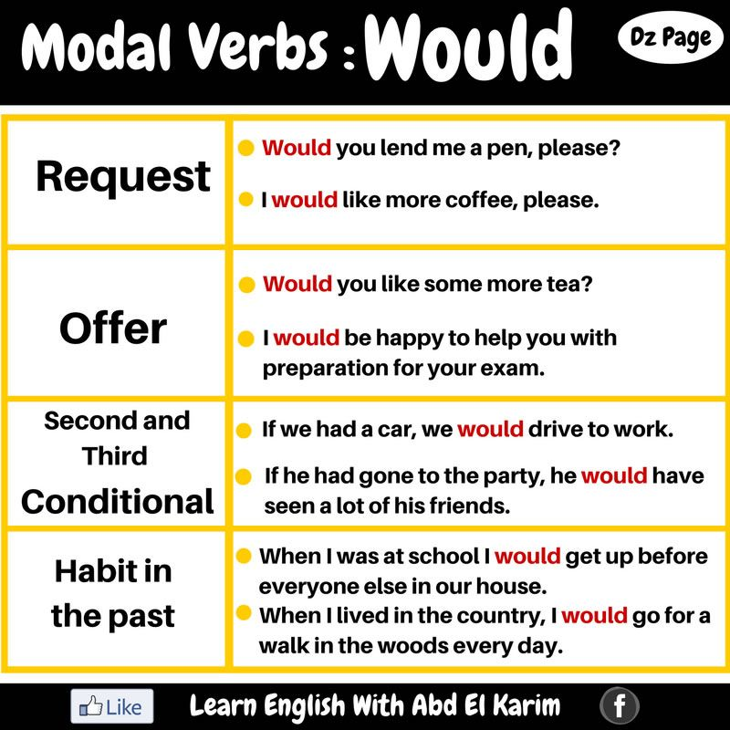

Slide 32
Poll Question
Which of the following is not a function of modal verb ‘WOULD’?
A. to make request
B. to give offer
C. habit in past
D. to use in a zero onditional

Slide 33
Answer
Option-D

Slide 34
MORE EXAMPLES
You said we would go to the movie.
If I were in trouble, I would ask him for help.
If I had been in trouble, I would have asked him for help.
When we were kids, we would always play street hockey in the alley.
Would you like a glass of orange juice?
Would you close the door , please?

Slide 35
Poll Question
. I _________ like to buy the same television for my house.
a) Could
b) Should
c) Would
d) May

Slide 36
Answer
Option- C

Slide 37
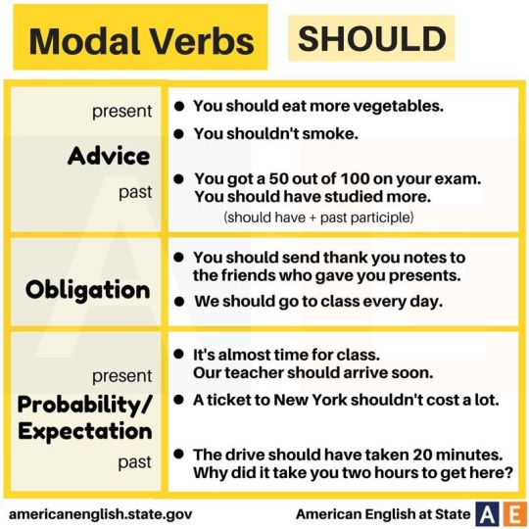

Slide 38
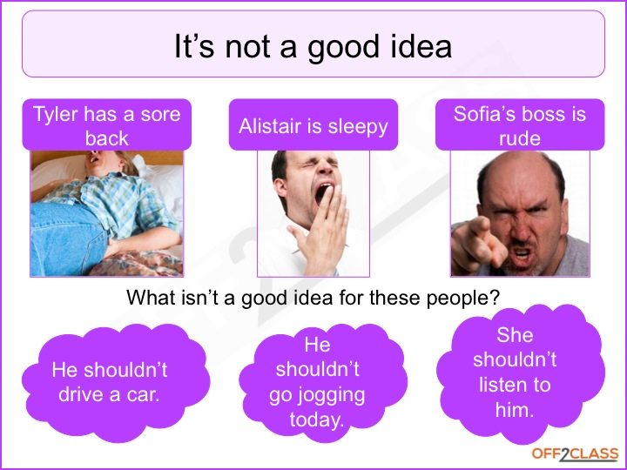

Slide 39
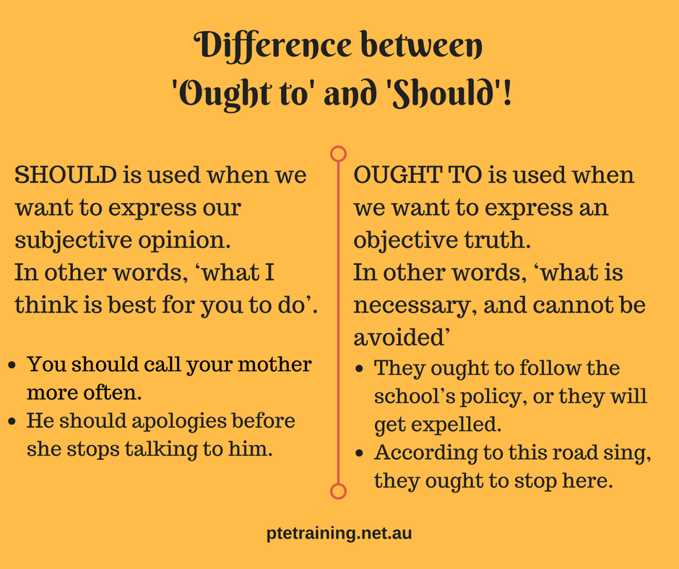

Slide 40
Poll Question
Which modals do you use to give advice?
A can
B. might
C. should
D. could

Slide 41
Answer
OPTION -C

Slide 42
MORE EXAMPLES
I should return this library book.
She should be at the airport right now.
You should do more exercise.
When you go to London, you should go to the theatre.
I should be going now. It's getting late.

Slide 43
Poll Question
You _________ eat more vegetables. They are healthy for you.
A) May
B) Would
C) Should
D) Might

Slide 44
Answer
Option -C

Slide 45
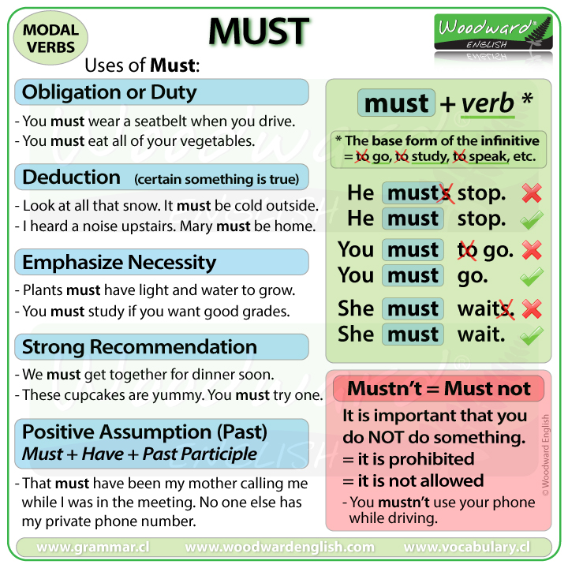

Slide 46
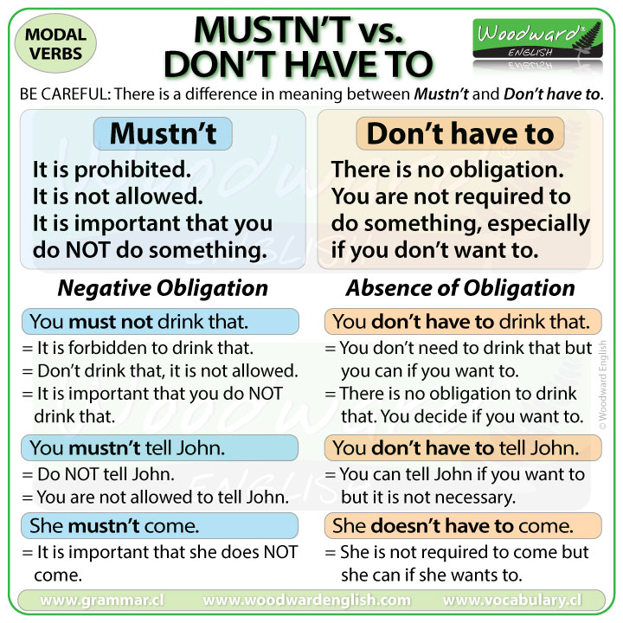

Slide 47
Poll Question
Which modal is used to express necessity?
A. should
B. ought to
C. could
D. must

Slide 48
Answer
OPTION- D

Slide 49
MORE EXAMPLES:-
She must be the best athlete in our school’s history.
To be healthy, you must eat well.
Visitors must sign in at reception.
You must not disrupt his concentration.

Slide 50
Poll Question
I think that sign means we ________ enter the building. Look, there's a security guard too.
A )Won’t
B) Mustn’t
C) Have to
D) Will

Slide 51
Answer
Option- B

Slide 52

Quick REVIEW

Slide 53
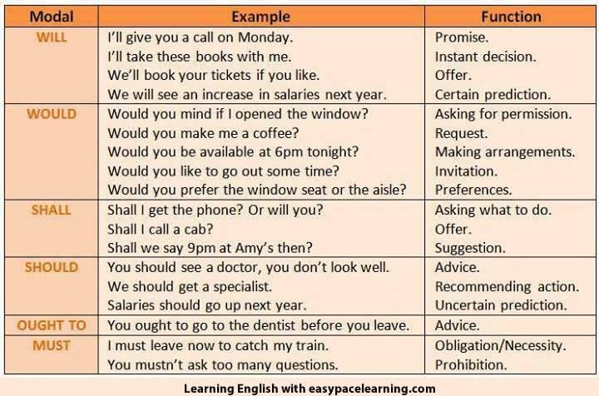

Slide 54
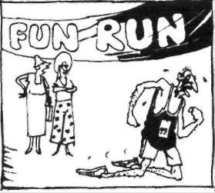
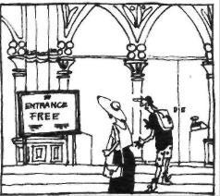
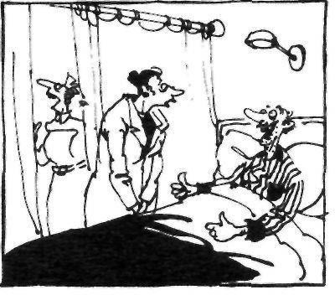
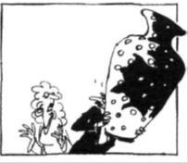
Activity- Make sentences for each picture using modal verbs.

Slide 55
THANK YOU

